Slide 1
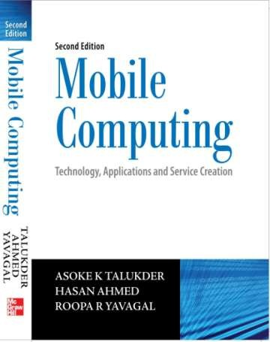
Mobile Computing
Chapter 4 Emerging Technologies
Asoke K Talukder
Hasan Ahmed
© Tata McGraw Hill

Slide 2
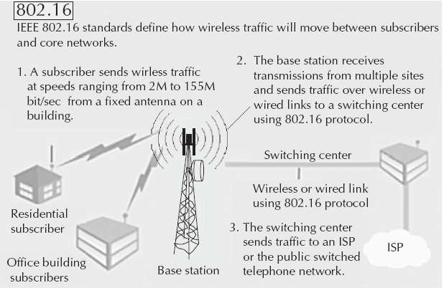
Overview of IEEE 802.16

Slide 3
Sub-standards of IEEE 802.16
IEEE 802.16.1 - Air interface for 10 to 66 GHz
IEEE 802.16.2 - Coexistence of broadband wireless access
systems
IEEE 802.16.3 - Air interface for licensed frequencies, 2 to 11 GHz

Slide 4
Basics of IEEE 802.16
IEEE 802.16 standards are concerned with the air interface between a subscriber’s transceiver station and a base transceiver station
The Physical Layer
MAC Layer
Convergence Layer

Slide 5
Physical Layer
Specifies the frequency band, the modulation scheme, error- correction techniques, synchronization between transmitter and receiver, data rate and the multiplexing structure
Both TDD and FDD alternatives support adaptive burst profiles in which modulation and coding options may be dynamically assigned on a burst-by-burst basis
Three physical layer for services: Wireless MAN-
SC2, Wireless MAN-OFDM and Wireless MAN-OFDMA

Slide 6
Medium Access Control Layer
Designed for point-to-multipoint broadband wireless access
Addresses the need for very high bit rates, both uplink (to the
base station) and downlink (from the base station)
Services like multimedia and voice can run as 802.16 MAC is equipped to accommodate both continuous and bursty traffic

Slide 7
Convergence Layer
Provides functions specific to the service being provided
Bearer services include digital audio/video multicast, digital telephony, ATM, Internet access, wireless trunks in telephone networks and frame relay

Slide 8
Mobile IP
‘Mobile IP’ signifies that, while a user is connected to
applications across the Internet and the user’s point of attachment changes dynamically, all connections are maintained despite the change in underlying network properties
Similar to the handoff/roaming situation in cellular network
Mobile IP allows the mobile node to use two IP addresses called home address and care of address
The home address is static and known to everybody as the identity of the host
The care of address changes at each new point of attachment and can be thought of as the mobile node’s location specific address

Slide 9
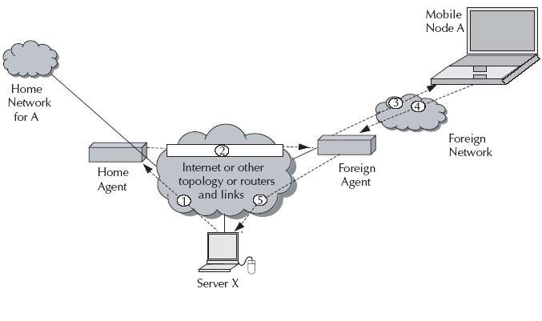
Working of Mobile IP

Slide 10
Working of Mobile IP
Let’s take the case of mobile node (A) and another host (server X). The following steps take place:
Server X wants to transmit an IP datagram to node A. The home address of A is advertised and known to X. X does not know whether A is in the home network or somewhere else. Therefore, X sends the packet to A with A’s home address as the destination IP
address in the IP header. The IP datagram is routed to A’s home
network.

Slide 11
Working of Mobile IP
At the A’s home network, the incoming IP datagram is intercepted by the home agent. The home agent discovers that A is in a foreign network. A care of address has been allocated to A by this foreign network and available with the home agent. The home agent encapsulates the entire datagram inside a new IP
datagram, with A’s care of address in the IP header. This new datagram with the care of address as the destination address is retransmitted by the home agent.
At the foreign network, the incoming IP datagram is intercepted by the foreign agent. The foreign agent is the counterpart of the home agent in the foreign network. The foreign agent strips off the outer IP header, and delivers the original datagram to A.

Slide 12
Working of Mobile IP
A intends to respond to this message and sends traffic to X. In this example, X is not mobile; therefore X has a fixed IP address. For routing A’s IP datagram to X, each datagram is sent to some router in the foreign network. Typically, this router is the foreign
agent. A uses X’s IP static address as the destination address in the IP header.
The IP datagram from A to X travels directly across the network, using X’s IP address as the destination address.

Slide 13
Working of Mobile IP
Discovery - A mobile node uses a discovery procedure to identify prospective home agents and foreign agents.
Registration - A mobile node uses a registration procedure to inform its home agent of its care-of address.
Tunneling - Tunneling procedure is used to forward IP datagrams from a home address to a care of address.

Slide 14
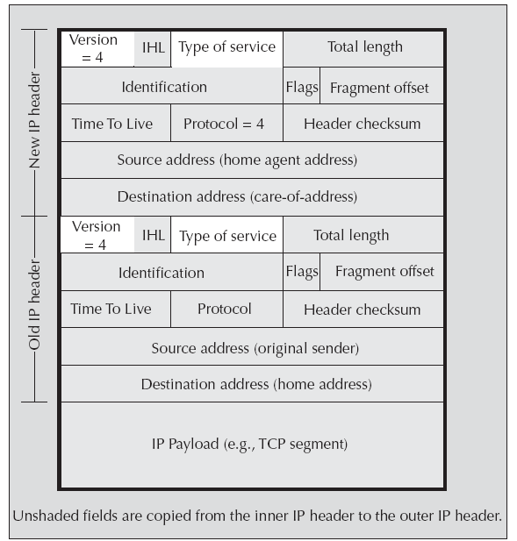
IP headers in Mobile IP

Slide 15
Cellular IP
None of the nodes know the exact location of a mobile host. Packets addressed to a mobile host are routed to its current base station on a hop-by-hop basis where each node only needs to know on which of its outgoing ports to forward packets. This limited routing information (referred as mapping) is local to the node and does not assume that nodes have any knowledge of the wireless network topology. Mappings are created and updated based on the packets transmitted by mobile hosts.

Slide 16
Cellular IP
Uses two parallel structures of mappings through Paging Caches (PC) and Routing Caches (RC)
PCs maintain mappings for stationary and idle (not in data communication state) hosts
RC maintains mappings for mobile hosts
Mapping entries in PC have a large timeout interval, in the order of seconds or minutes. RCs maintain mappings for mobile hosts currently receiving data or expecting to receive data

Slide 17
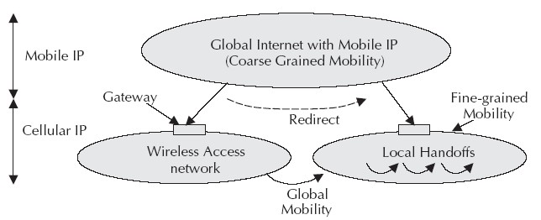
Relationship between Mobile IP and Cellular IP

